Slide 1

Bahria University Karachi Campus
Data Mining
Department of Software Engineering
Bahria University Karachi Campus
Notes:
https://www.youtube.com/watch?v=9OjRP0ZLKkk&list=PLLspfyoOYoQcI6Nno3gPkq0h5YSe81hsc&index=32

Slide 2
Agglomerative clustering

Slide 3
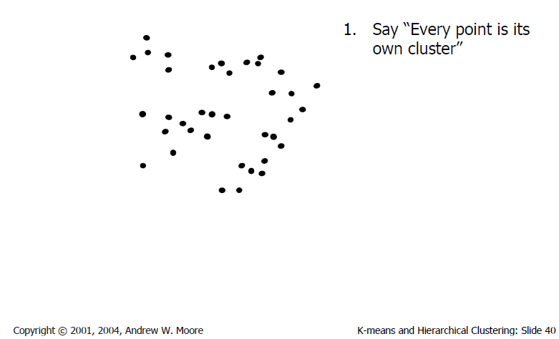
Agglomerative clustering

Slide 4
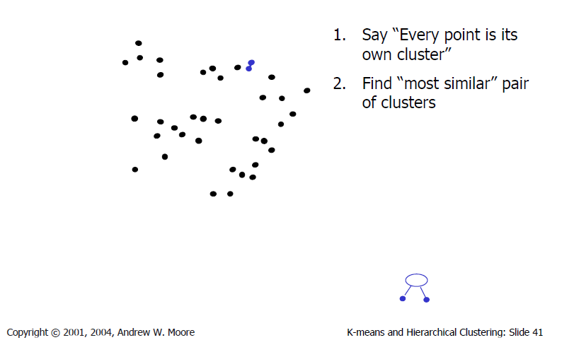
Agglomerative clustering

Slide 5
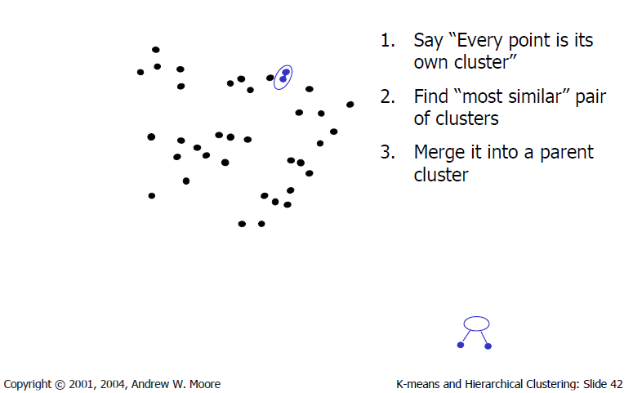
Agglomerative clustering

Slide 6
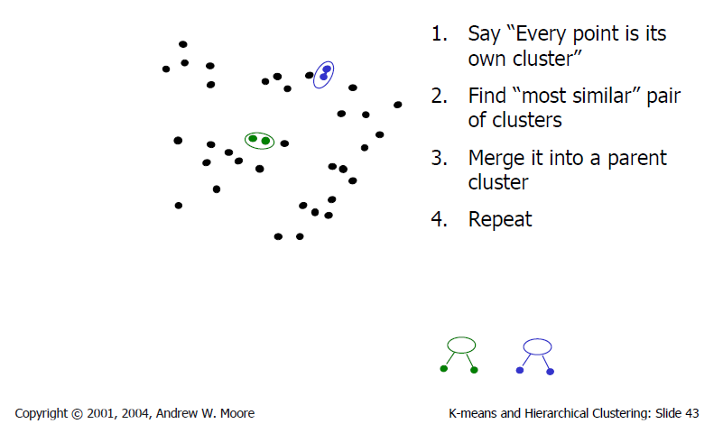
Agglomerative clustering

Slide 7
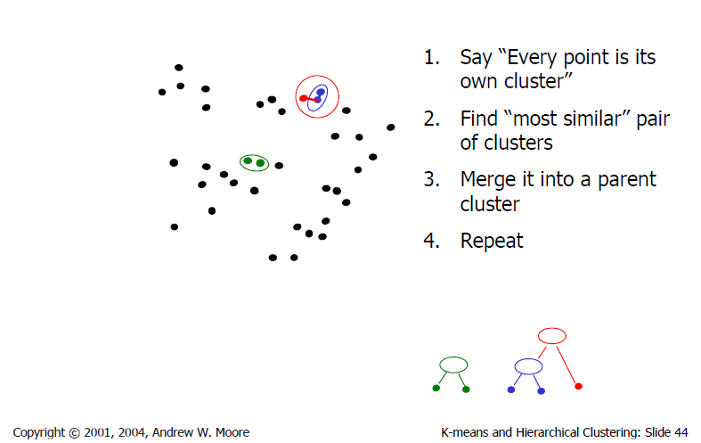
Agglomerative clustering

Slide 8
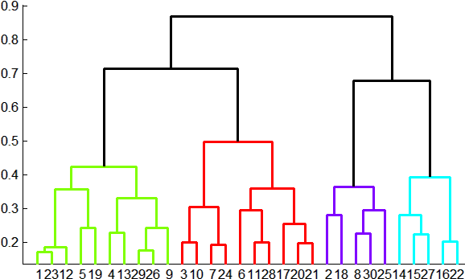
Agglomerative clustering
How to define cluster similarity?
Average distance between points, maximum distance, minimum distance
Distance between means
How many clusters?
Clustering creates a dendrogram (a tree)
Threshold based on max number of clusters or based on distance between merges
distance

Slide 9
Conclusions: Agglomerative Clustering
Good
Simple to implement, widespread application
Provides a hierarchy of clusters
Bad
May have imbalanced clusters
Still have to choose number of clusters or threshold

Slide 10
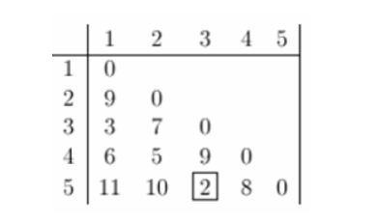
Example
Clustering starts by computing a distance between every pair of units that you want to cluster.
A distance matrix will be symmetric and will have zeroes on the diagonal (because every item is distance zero from itself).
The table below is an example of a distance matrix. Only the lower triangle is shown, because the upper triangle can be filled in by reflection.

Slide 11
The smallest distance is between three and five and they get linked up or merged first into a the cluster '35’.
To obtain the new distance matrix, we need to remove the 3 and 5 entries, and replace it by an entry "35" .
Since we are using complete linkage clustering, the distance between "35" and every other item is the maximum of the distance between this item and 3 and this item and 5. For example, d(1,3)= 3 and d(1,5)=11. So, D(1,"35")=11. This gives us the new distance matrix.

Slide 12
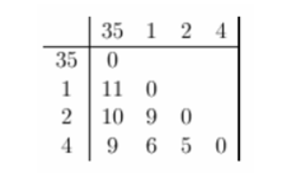
The items with the smallest distance get clustered next. This will be 2 and 4.

Slide 13
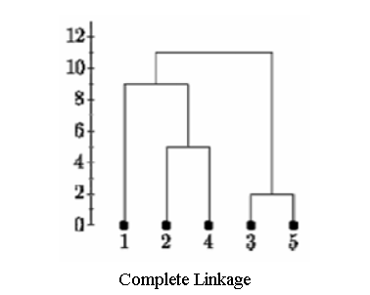
Continuing in this way, after 6 steps, everything is clustered.

Slide 14
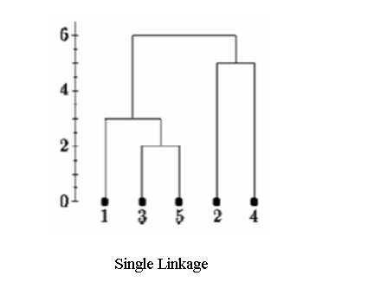
Below is the single linkage dendrogram for the same distance matrix. It starts with cluster "35" but the distance between "35" and each item is now the minimum of d(x,3) and d(x,5). So c(1,"35")=3.

Slide 15
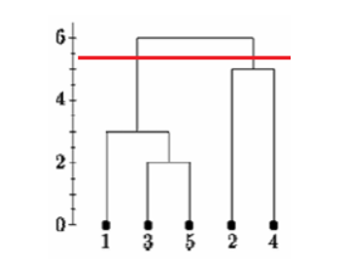
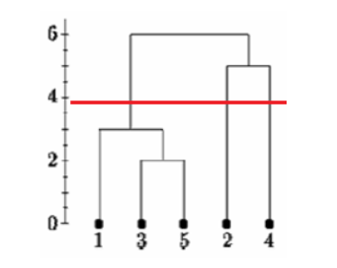
Determining clusters

